Slide 1
Lecture 7
Case study

Slide 2
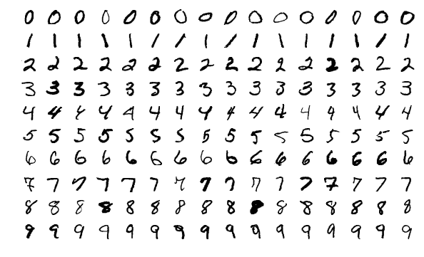
Case study: handwritten digit recognition
Goal: recognize the digit ‘5’
Source: MNIST database
Notes:
To finish this lesson on machine learning we will present a case study
This case study will use all the concepts we learned in this lesson on machine learning
Our aim is to train an algorithm able to recognize hand-written digits
The data set we use is an open source data set: the so-called MNIST database
MNIST stands for Modified National Institute of Standards and Technology database
It is a large database of handwritten digits. It contains pictures of handwritten digits from adults and children
All images are formatted to be grey scale images and further all have the same size
Our goal will be to train an algorithm able to recognize the images containing the digit 5

Slide 3












Problem formulation
Features:
Labels:
$$x_{1}$$
$$x_{2}$$
$$x_{3}$$
$$x_{4}$$
$$x_{5}$$
$$\underline{x}=\left[\begin{matrix}\begin{aligned}1 \\ x_{1}\end{aligned} \\ \begin{aligned}x_{2} \\ x_{3} \\ ⋮\end{aligned} \\ x_{n}\end{matrix}\right]$$
$$x_{6}$$
$$⋯$$
$$⋯$$
$$x_{n}$$
$$n=784$$
$$y=\left\{\begin{aligned}0 \\ &1\end{aligned}\right.$$
If picture does not represents the digit ‘5’
If picture represents the digit ‘5’
Notes:
Let us formulate the problem
Each image contains 784 pixels. We will number these pixels from 1 to 784 and they will be our features
The feature vector $\underline{x}$ of a an instance, or if you prefer of an image, will be the column vector containing a 1 in the first line followed by the 784 pixel entries of the image
The labels y will equal to 0 if the image does not represents the digit ‘5’ and will be equal to one if the picture represents the digit ‘5’

Slide 4












Problem formulation
Data set: collection of labeled pictures
$$⋯$$
$${\underline{x}}^{(1)}$$
$${\underline{x}}^{(2)}$$
$${\underline{x}}^{(3)}$$
$$⋯$$
$${\underline{x}}^{(m)}$$
$$y^{(1)}$$
$$y^{(2)}$$
$$y^{(3)}$$
$$⋯$$
$$y^{(m)}$$
$$m={70}^{′}000$$
Notes:
The data set itself contains 70’000 pictures
So in our problem, n, the number of features, is 784 and m, the number of instances, is equal to 70’000
You will not the large amount of data we will have to handle

Slide 5
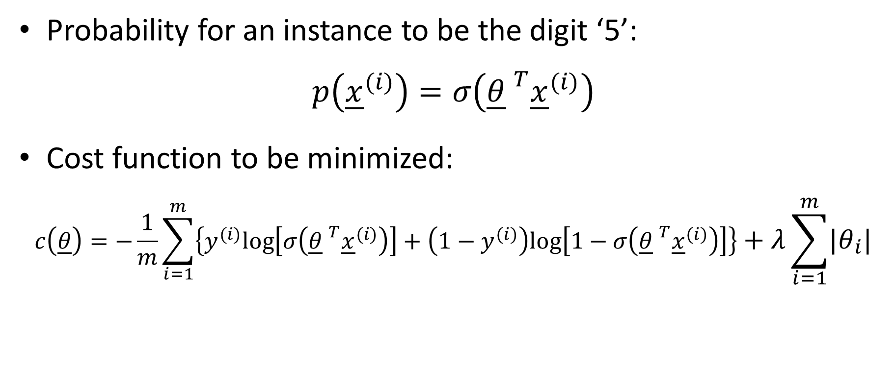
Problem formulation
Probability for an instance to be the digit ‘5’:
$$p\left({\underline{x}}^{(i)}\right)=σ\left({\underline{θ} }^{T}{\underline{x}}^{(i)}\right)$$
Cost function to be minimized:
$$c\left(\underline{θ}\right)=−\frac{1}{m}\sum_{i=1}^{m}{\left\{y^{(i)}\text{log}\left[σ\left({\underline{θ} }^{T}{\underline{x}}^{(i)}\right)\right]+\left(1−y^{(i)}\right)\text{log}\left[1−σ\left({\underline{θ} }^{T}{\underline{x}}^{(i)}\right)\right]\right\}+λ\sum_{i=1}^{m}{\left|θ_{i}\right|}}$$
Log-loss function
LASSO regularization
Notes:
The model we want to train is the probability of being a digit 5.
For this we use the logistic function.
So the probability $p\left({\underline{x}}^{(i)}\right)$ is equal to $σ\left({\underline{θ} }^{T}{\underline{x}}^{(i)}\right)$
Note that this involves 784 features
You may take some minutes to think about the meaning of this equation.
Why, a linear combination of pixels should be related to the probability to be a certain digit?
In fact if you think about how you write the digit ‘5’ then you can understand why such a relation should exist.
In average, when you write a digit ‘5’, essentially the same pixels will be black and essentially the same ones white.
So the weights of the pixels that are usually in black when writing a 5 should be high and the other ones low
To fit the model to the data set we need a cost function
We use the one displayed on the slide
It is made of the sum of the log-loss function that is used in logistic regression and the LASSO regularization term.
This regularization term is needed as we have a model with many features and most likely we would do over-fitting without this term
Once you finish this lecture you may want to try out by yourself training of the data set with different values of this hyper-parameter
In particular try out the value 0 to realize that the trained model will have very poor quality. It won’t be able to recognize properly the digit ‘5’
This is because in this case we do over-fitting

Slide 6
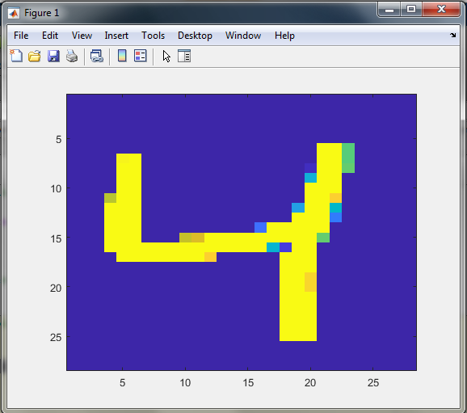
Solving with Matlab
Step 1: get the data set
>> d=load('mnist.mat');
>> X=d.trainX;
>> y=d.trainY;
>> i=3;
>> img = reshape(X(i,:), 28, 28)';
>> image(img);
>> y(i)
ans =
uint8
4
Notes:
Let us dive into tackling this problem
As a first step we need to get the data
For this we use a file that you can download from the internet
[Note: source of the data file is here: https://github.com/daniel-e/mnist_octave]
We load the content of the file with the matlab command load
The file contains several ready to use data sets
The one we are interested in is the training set which contains a matrix d.trainX with the instances and a column vector Y.train with the labeled conent of the pictures.
Let us illustrate how to use these data
As an example we will look at the third image, so we define i=3
To be able to get the image we need to reshape the vector containing the pixels into the original shape of the image with the reshape command. The original images had 28 times 28 pixels
With the command image we can display the image.
We realize that it contains a picture of a hand written digit 4
The corresponding label y contains the number 4 as expected

Slide 7
Solving with Matlab
Step 2: label properly the data
Step 3: training logistic regression with LASSO regularization
>> y_5= (y==5)';
>> [B,FitInfo] = lassoglm(double(X), y_5, 'binomial', 'lambda', [0.0001]);
>> theta=[FitInfo.Intercept; B];
Notes:
As we want to recognize the digit ‘5’ we need to re-label our labels
We create a column vector y_5 which contains Boolean values. It contains a TRUE if the image depicts a digit ‘5’ and FALSE in other cases
We then proceed with the logistic regression using LASSO regularisation
Matlab has an in-built function for this task
The syntax is as shown on the slide
It is in fact similar to the lasso function
The first input argument is a matrix containing column by column the features of the data set
In our case, as the pixels are not stored as floating numbers, we need to convert them to double. That is required by the lassoglm function
The second input argument is our label vector
And the following input arguments tell the function to use logistic regression, lasso regularization and the last argument is the value of the hyper-parameter lambda we want to use in the LASSO regularization term
We don’t discuss how we chose this value. Let us say we found it by trial and error.
The matlab function returns the vector B containing the feature weights and the structure FitInfo which has same content as in the case of the lasso function
We can construct our fitted feature weight vector theta based on B and FitInfo

Slide 8
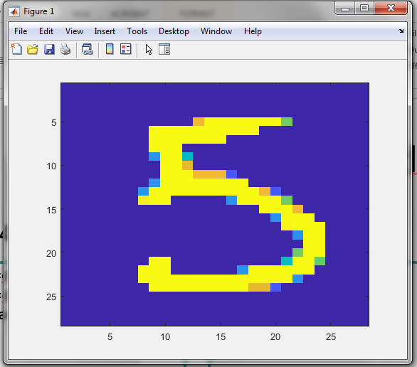

Solving with Matlab
Step 4: Using the trained model to make predictions:
>> xval=d.testX;
>> yval=d.testY;
>> sigma=@(t) 1/(1+exp(-t));
>> i=16;
>> xi=[1 double(xval(i,:))]';
>> sigma(theta'*xi)
ans =
0.9021
>> yval(i)
ans =
5
>> img = reshape(xval(i,:), 28, 28)';
>> image(img)
$${\underline{x}}^{(16)}=\left[\begin{matrix}\begin{aligned}1 \\ x_{1}\end{aligned} \\ \begin{aligned}x_{2} \\ x_{3} \\ ⋮\end{aligned} \\ x_{n}\end{matrix}\right]$$
Notes:
Having trained our model we can now try it out
It wouldn't be honest to try it on the same data set than the one we used to train the model
Therefore we use another data-set with images having same format
The loaded data which we used for the training set contains as well a test set
This test set contains a matrix d.testX with images and the labels d.testY.
Let us store the in xval and yval
We further define the logistic function as we will need it
Let us try our trained model on the image number 16 of the test set
We store in the column vector xi the features of this image
We can now compute with which probability this image is a digit ‘5’
For this we simply compute sigma(theta'*xi)
Our trained model claims this is a digit ‘5’ with a probability of 90%
If we check the entry in the label 16 it confirms that indeed we have a digit 5
As further confirmation we can display the image and we indeed see a digit ‘5’
I invite you to play with this model and try out more predictions from the test set

Slide 9
Summary
We trained a model by logistic regression to recognize the hand written digit ‘5’
As the model involves a large amount of features, LASSO regularization was required to avoid over-fitting
Matlab implements all the needed algorithms for this task
Notes:
Let us summarize the key findings
We trained a model by logistic regression to recognize the hand written digit ‘5’
Matlab implements all the needed algorithms for this task
As the model involves a large amount of features, LASSO regularization was required to avoid over-fitting

